Slide 1
What are the Best Types of Renewable Energy? – Part 1
2022 Climate Superstars Task #7

Slide 2
Learning Objectives
After completing this task, you will be able to…
Explain the difference between renewable and green energy sources.
State the main benefits of green energy.
Explain why lifecycle analysis of renewables helps clarify which energy technologies are the greenest.

Slide 3
Vocabulary
Conventional power - includes the combustion of fossil fuels (coal, natural gas, and oil) and the nuclear fission of uranium. Fossil fuels have environmental costs from mining, drilling, or extraction, and they emit greenhouse gases and air pollution during combustion. Although nuclear power generation emits no greenhouse gases during power generation, it does require mining, extraction, and long-term radioactive waste storage.
Green power - a subset of renewable energy. It represents those renewable energy resources and technologies that provide the greatest environmental benefit. Green power is defined as electricity produced from solar, wind, geothermal, biogas, eligible biomass, and low-impact small hydroelectric sources.
Lifecycle analysis - used to assess the overall greenhouse gas (GHG) impacts of a fuel, including each stage of its production and use.
Renewable energy - resources that rely on fuel sources that restore themselves over short periods of time and do not diminish. Such fuel sources include the sun, wind, moving water, organic plant and waste material (eligible biomass), and the earth's heat (geothermal).

Slide 4
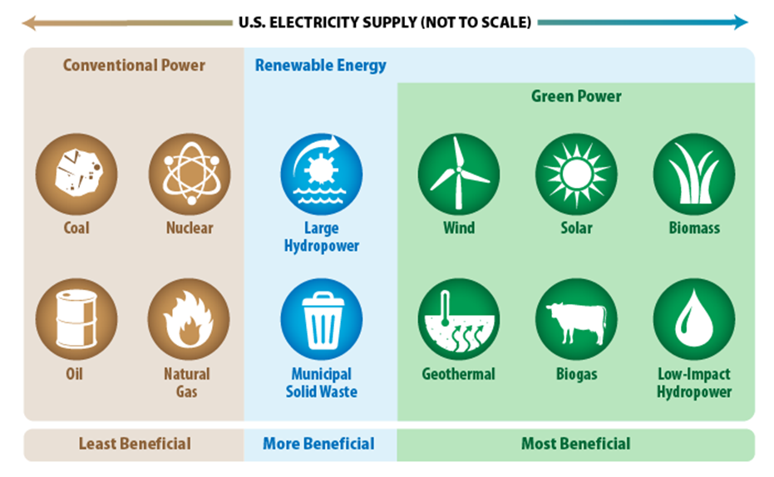
Comparing Renewable Energy Sources
In the Learn About Renewable Energy activity, several types of energy were introduced
The graphic to the right organizes them according to their respective beneficial environmental impacts.
Which energy types are available in your community?
Source: EPA

Slide 5
Comparing Renewable Energy Sources
This activity focuses on answering the question, what are the best types of green power?—that are not hydropower based. (Hydropower will be the focus of Part 2 of this activity.) To come up with an answer requires looking at both the benefits and impacts – a lifecycle analysis – of the various types.
For example, biomass. While being “green” in some ways, renewable energy sources like biomass are polluting in other ways. The complexities of figuring out which renewables are truly green are illustrated in the following video on wood pellets that are produced in the United States for use in European Union nations.

Slide 6
Watch this video to learn about the benefits versus the impacts of one type of renewable energy
https://www.cnn.com/interactive/2021/07/us/american-south-biomass-energy-invs/

Slide 7
Watch this video explainer to learn about the renewable energy source called biomass.
https://www.youtube.com/watch?v=yHWcddUZ35s

Slide 8
Watch this video explainer to learn about the renewable energy source called geothermal.
https://www.youtube.com/watch?v=DFQrE91kZwk

Slide 9
Watch this video explainer to learn about the renewable energy source called solar photovoltaic
https://www.youtube.com/watch?v=gl5tY5Noacc

Slide 10
Watch this video explainer to learn about the renewable energy source called solar thermal.
https://www.youtube.com/watch?v=FgjfJGfusdE

Slide 11
Watch this video explainer to learn about the renewable energy source called wind power
https://www.youtube.com/watch?v=Z5c50-_hcD0

Slide 12
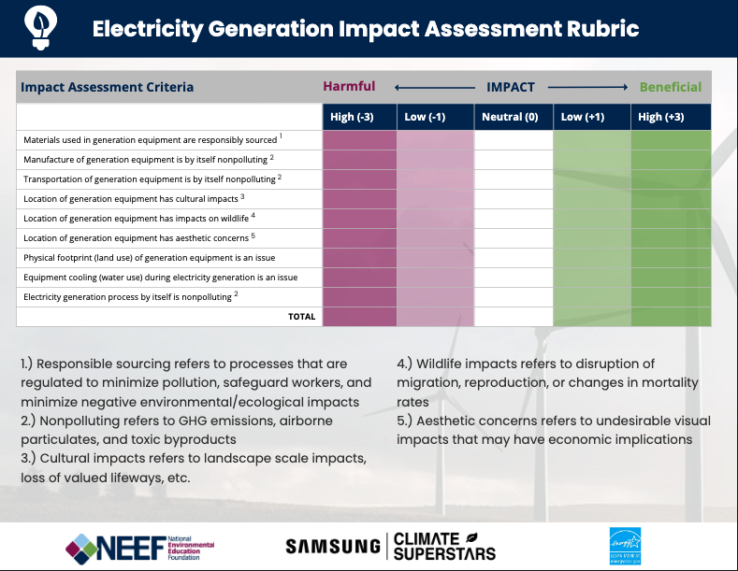
Action Item
Complete an Electricity Generation Impact Assessment Rubric (download from the Resource Library) for each type of renewable energy.
Debate the pros and cons of non-hydropower based renewable versus green energy using your set of Electricity Generation Impact Assessment Rubrics as evidence to evaluate.

